Slide 1


A Brief Introduction to
Artificial Intelligence
Qinghua Zheng
School of Computer Science & Technology,
Xi’an Jiaotong University
Notes:
疫情，助教没有来。注意安全，不要乱跑，听从学校指挥。正好，可以好好复习，期末成绩对大家很重要。
同学们，今天我们来讲人工智能。人工智能是计算机科学的一个分支，以计算机为基础。我国急需人工智能人才，高校的学科中，已经是一门和计算机一级学科了，所以内涵很丰富，1节课的时间很短，我们带大家简要领略一下人工智能研究的问题，和方法，以及未来的趋势。

Slide 2



PART A
Big Event: AlphaGo vs Professional
Notes:
Warm up 一下，让我们先来看人工智能的里程碑事件

Slide 3

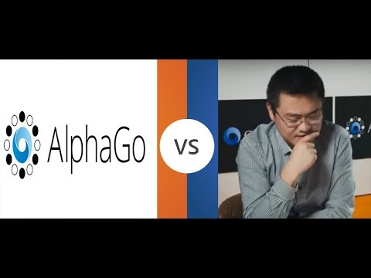
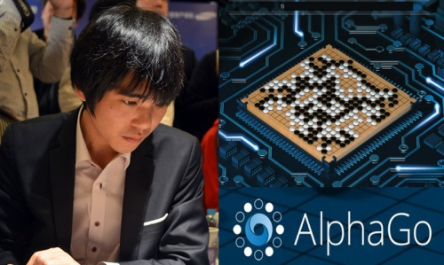
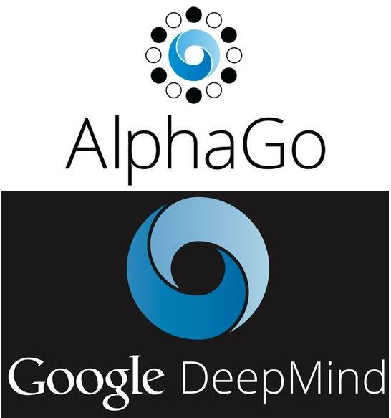
1
AlphaGo
PART
PART
PART
AlphaGo：a computer program developed by Google DeepMind in London to play the board game Go^{[1]}.
2015.10
Alphago 5:0 Fan Hui (2 dan Pro.)
2016.3
Alphago 4:1 Lee Sedol (9 dan Pro.)
[1] "Artificial intelligence: Google's AlphaGo beats Go master Lee Se-dol". BBC News. Retrieved 17 March 2016.
[2] "Research Blog: AlphaGo: Mastering the ancient game of Go with Machine Learning". Google Research Blog. 27 January 2016.
[3] "Google achieves AI 'breakthrough' by beating Go champion". BBC News. 27 January 2016.
[4] "Match 1 - Google DeepMind Challenge Match: Lee Sedol vs AlphaGo". 8 March 2016.
Notes:
2015.10 -- it became the first Computer Go program to beat a professional human Go player without handicaps on a full-sized 19×19 board.^{[2][3]}
2016.03 -- it beat Lee Sedol in a five-game match, the first time a computer Go program has beaten a 9-dan professional without handicaps.^{[4]}

Slide 4
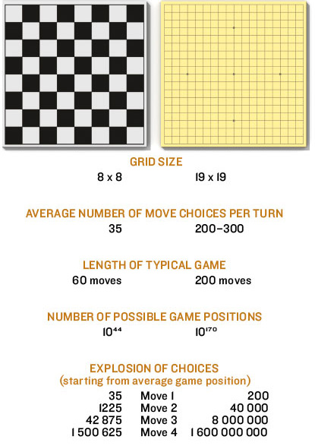
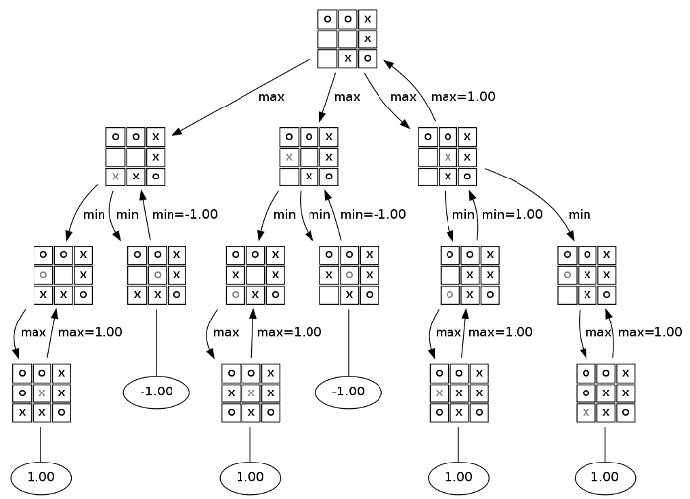
1
What makes this moment different?
PART
PART
PART
Game | Complexity | Status
Tic-tac-toe | 10³ | Solved manually
Connect 4 | 10¹⁴ | Solved in 1988
Checkers | 10²⁰ | Solved in 2007
Chess | 10⁴⁴ | Programs > best humans
Go | 10¹⁷⁰ | Programs > best humans 2016
Traditional methods not work in Go
The search space is too huge
Approximate evaluation
Reasoning with uncertainty
Traditional search: Tic-tac-toe, Min-Max search
Notes:
为什么这个问题很特别，是里程碑呢？同样是棋类，计算机能下的棋很多呀。
让我们来看一下计算机可以完成的棋类，井字棋。我们来看一下这个棋的复杂度是多少。9！有些情况不需要走9步，有些情况对称的，完全等价。整个游戏也就的可能性1000为数量级。
再看一下国际象棋呢，chess。8*8的棋盘。每次大鱼油
近似估计。

Slide 5
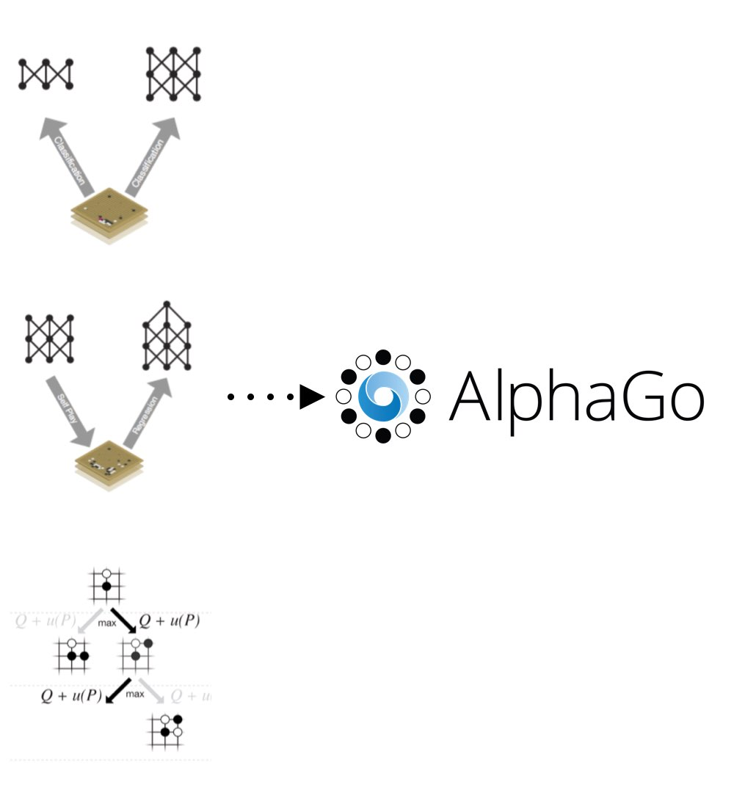
1
How does AlphaGo Work?
PART
PART
PART
Deep Learning
Reinforcement Learning
Monte Carlo Tree Search algorithm
http://www.dcine.com/2016/01/28/alphago/
http://www.afenxi.com/post/8713
http://chuansong.me/n/443550537049
https://www.zhihu.com/question/41176911
Notes:
AlphaGo's algorithm uses a Monte Carlo tree search to find its moves based on knowledge previously "learned" by machine learning, specifically by an artificial neural network (a deep learning method) by extensive training, both from human and computer play.

Slide 6
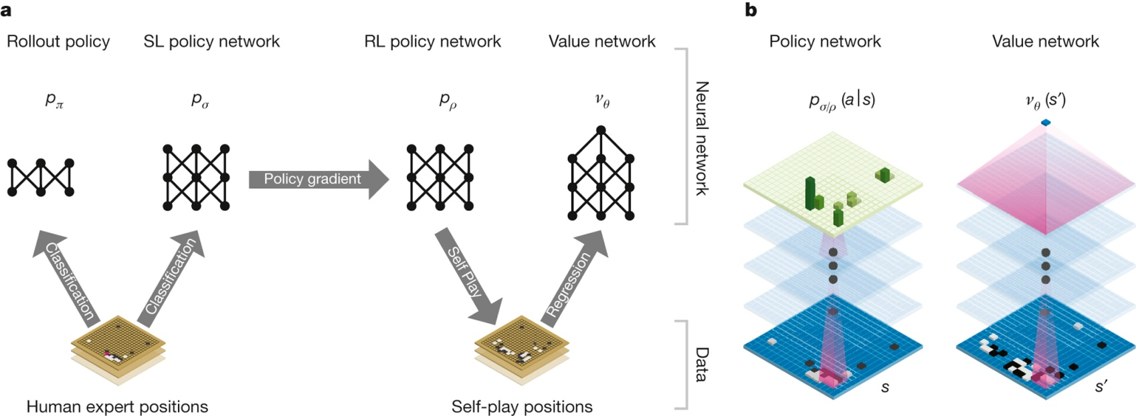
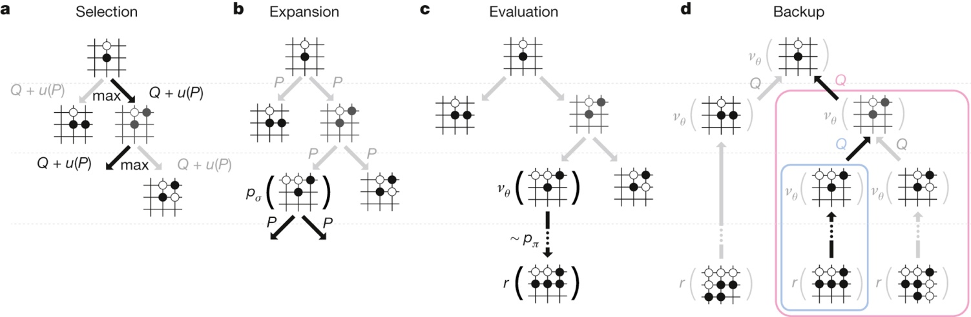
1
How does AlphaGo Work?
PART
PART
PART
Neural network training
Monte Carlo tree search
Notes:
决策网络（预测人类会走那步棋）
打分网络（自己走棋，）

Slide 7
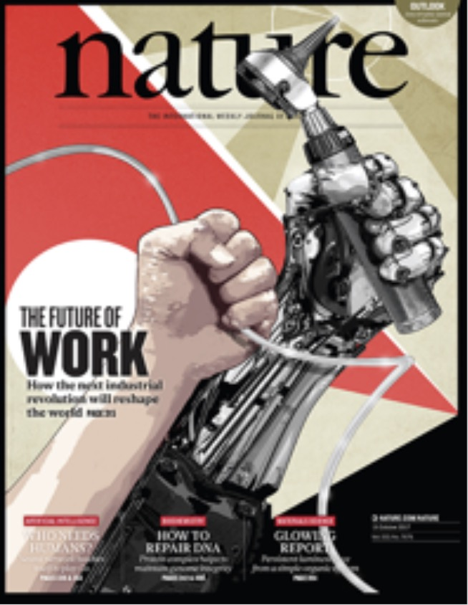
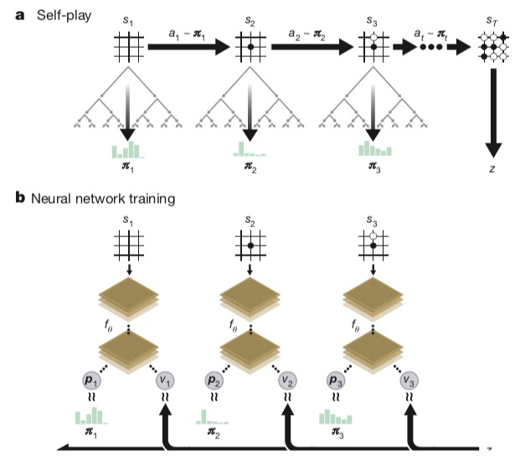
1
Deep Mind Team: From alphago to ZERO
PART
PART
PART
AlphaGo ZERO：AlphaGo becomes its own teacher
Here we introduce an algorithm based solely on reinforcement learning, without human data, guidance or domain knowledge beyond game rules.
Mastering the game of Go without human knowledge, Nature, 2017.10
Self-play reinforcement learning in AlphaGo Zero
Notes:
2017 年 10 月，DeepMind 公开了最新版本的 AlphaGo Zero，此版本在与 2016 年 3 月版的 AlphaGo 的对阵中取得了 100-0 的战绩，并且，在训练中未使用任何手工设计的特征或者围棋领域的专业知识，仅仅以历史的棋面作为输入，其训练数据全部来自于 self-play。
近日，DeepMind在Nature上公布了最新版AlphaGo论文，介绍了迄今为止最强的围棋人工智能(artificial intelligence, AI): AlphaGo Zero[5]。AlphaGo Zero不需要人类专家知识，只使用纯粹的深度强化学习技术和蒙特卡罗树搜索，经过3天自我对弈就以100比0击败了上一版本的AlphaGo。AlphaGo Zero证明了深度强化学习的强大能力，也必将推动以深度强化学习为代表的人工智能领域的进一步发展。

Slide 8
PART B
Artificial Intelligence vs Human Intelligence

Slide 9
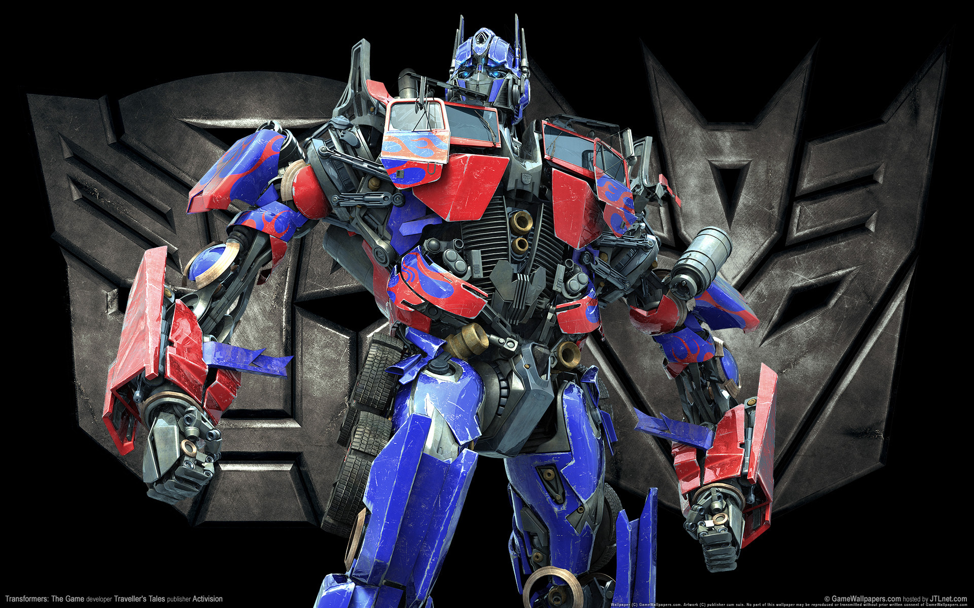
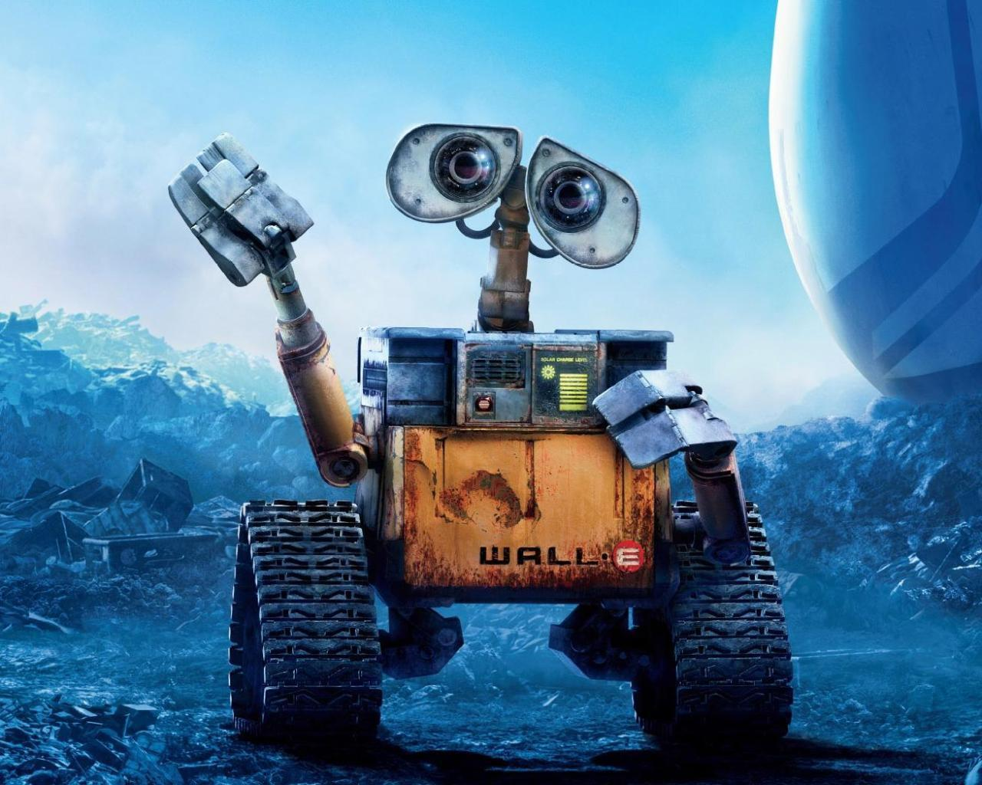
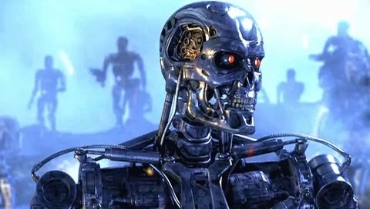
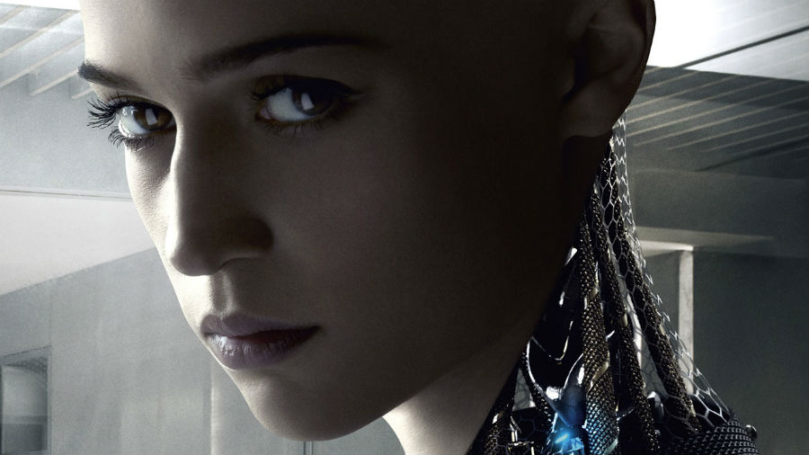
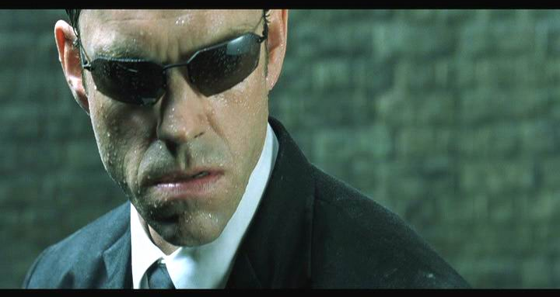
2
Fiction AI
PART
PART
PART
Notes:
Weak AI is the thinking focused towards the development of technology gifted of carrying out pre-planned moves based on some rules and applying these to achieve a certain goal.
Strong AI is emerging technology that can think and function same as like humans, not just imitating human behavior in a certain area.

Slide 10
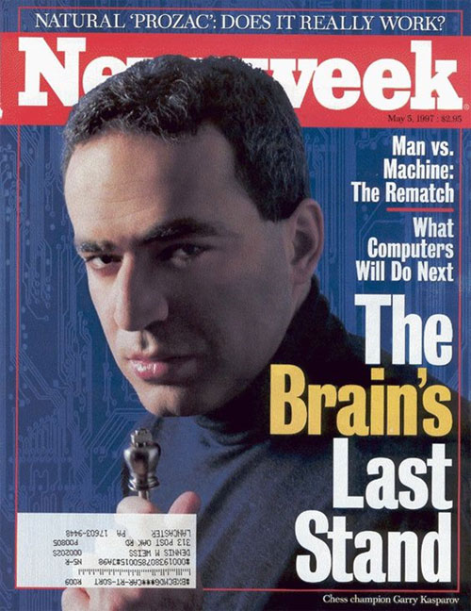
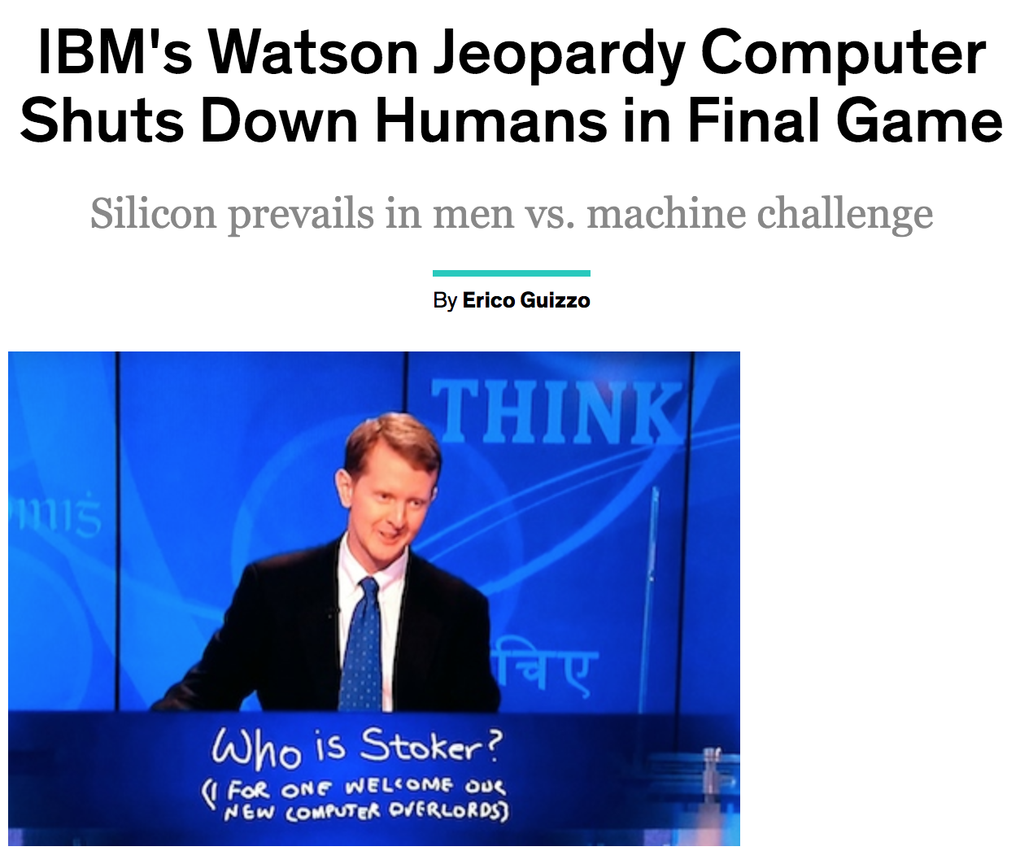
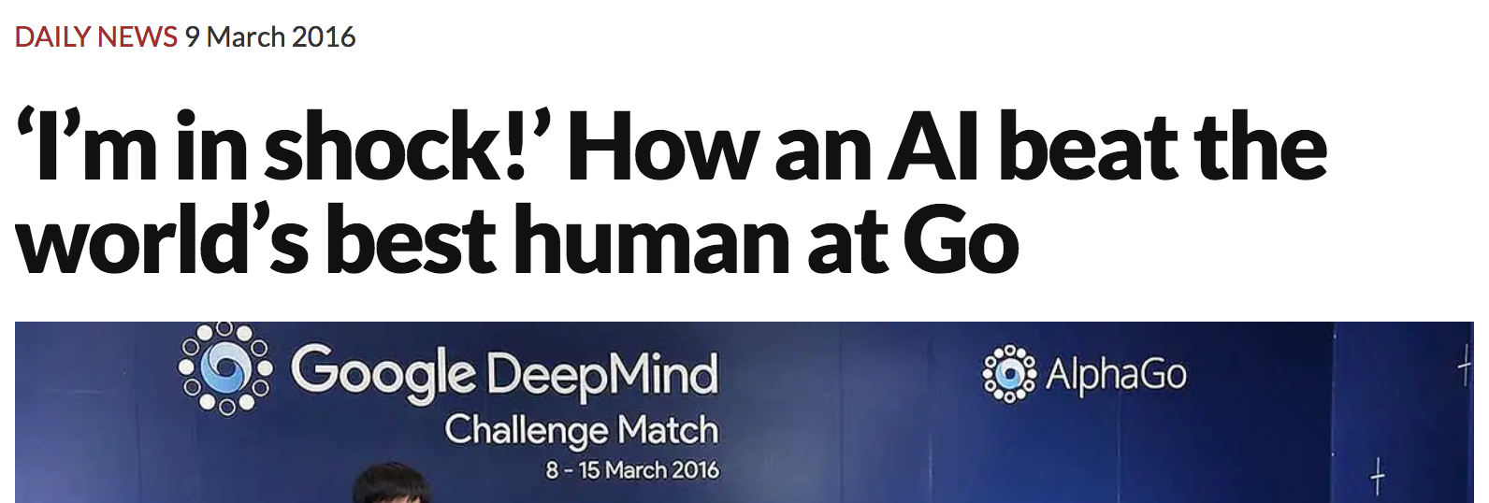
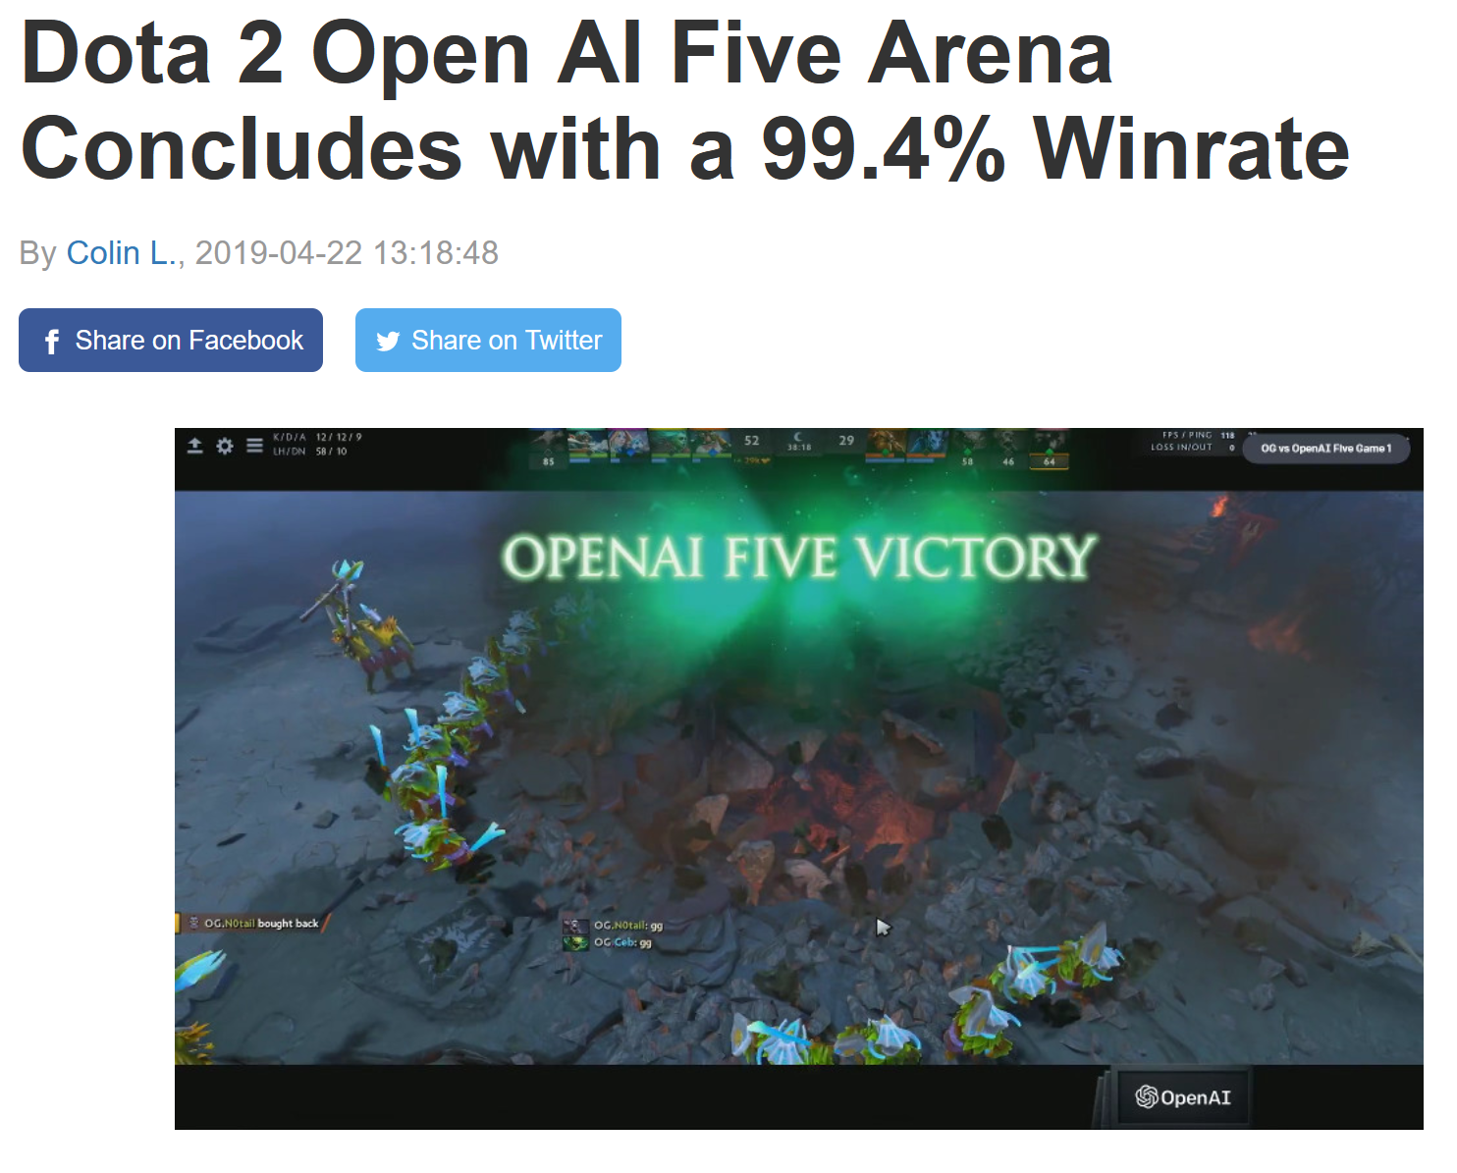
2
News AI
PART
PART
PART
Notes:
新闻下的人工智能。 人工智能也在一步步的实现，慢慢的超过人。

Slide 11
2
What is Human Intelligence?
PART
PART
PART
Human Intelligence (HI) is something related to the various other cognitive process in order to have adaption of specific environment
HI Featured with
something differently perceived and differently acquired
something natural, no artificiality is involved in it
The word “ intelligence” plays a vital role in human life
Notes:
human intelligence is something related to the adaption of various other cognitive process in order to have specific environment
HI Featured with
something differently perceived and differently acquired
something natural, no artificiality is involved in it
the word ”intelligence” plays a vital role because intelligence is with them all it’s need to cogitate and make a step by step plan for performing certain task. It’s a natural blessing that is with humans since their birth and no one can replace it except GOD.

Slide 12
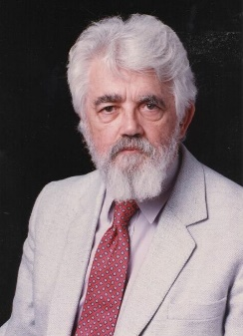
2
What is Artificial Intelligence?
PART
PART
PART
Artificial Intelligence is designed to add human like qualities in autonomous/robotic machines.
Its major function
To make the machines a good mimic of human beings.
Isn't there a solid definition of intelligence that doesn't depend on relating it to human intelligence?
Not yet. The problem is that we cannot yet characterize in general what kinds of computational procedures we want to call intelligent. We understand some of the mechanisms of intelligence and not others.
John McCarthy
Stanford University
Notes:
Weak AI is the thinking focused towards the development of technology gifted of carrying out pre-planned moves based on some rules and applying these to achieve a certain goal.
Strong AI is emerging technology that can think and function same as like humans, not just imitating human behavior in a certain area.

Slide 13
PART C
Academic Disciplines & History of AI

Slide 14
Academic Disciplines Relevant to AI
Academic Discipline:
Philosophy (reasoning, planning, learning, science, automation)
Mathematics (logic, probability, optimization)
Neuroscience (neurons)
Economics (rationality, game theory)
Control theory (feedback)
Psychology (learning, cognitive models)
Linguistics (grammars, formal representation of meaning)

Slide 15
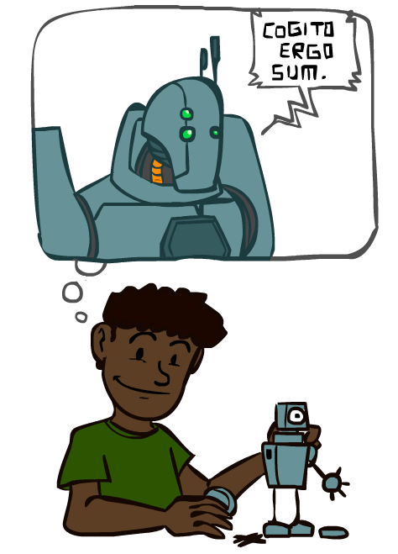
A short history of AI
1940-1950: Early days
1943: McCulloch & Pitts: Boolean circuit model of brain
1950: Turing's “Computing Machinery and Intelligence”
1950—70: Excitement!
1950s: Early AI programs: chess, checkers (RL), theorem proving
1956: Dartmouth meeting: “Artificial Intelligence” adopted
1965: Robinson's complete algorithm for logical reasoning
1970—90: Knowledge-based approaches
1969—79: Early development of knowledge-based systems
1980—88: Expert systems industry booms
1988—93: Expert systems industry busts: “AI Winter”
1990— 2012: Statistical approaches + subfield expertise
Resurgence of probability, focus on uncertainty
General increase in technical depth
Agents and learning systems… “AI Spring”?
2012— ___: Excitement again?
Big data, big compute, deep learning
AI used in many industries
Notes:
第一次人工智能热潮是推理与搜索时代。主要做的是求解迷宫问题、人机博弈、小游戏、自动定理证明等内容。明斯基指出了当时的问题。智能解决有限的小问题，人们觉得是玩具。所以失败
第二次热潮是知识，它和第一次浪潮中利用推理和搜索等简单规则不同，它仅仅依靠“知识”的支持。这里有一个概念叫“专家系统”，专家系统是指引入某个专业领域的知识，再经过推理，计算机便能够像该领域的专家一样出色工作。第一个是MYCIN系统，MYCIN系统是 20世纪70 年代初由斯坦福大学研制的，它是一种帮助医生对住院的血液感染患者进行诊断和选用抗菌素类药物进行治疗的人工智能，使用了人工智能的早期模拟决策系统，用来进行严重感染时的感染菌诊断以及抗生素给药推荐。知识导入使得计算机变得更聪明，但知识描述之复杂与困难超出了当初预想，知识的输入是无穷无尽的，因此到1995年左右开始，人工智能研究又一次迎来寒冬。
漫长的寒冬也有一些进展，统计概率的方法对不确定性问题，行为主义。
第三次热潮是深度学习和大数据时代
“符号主义”（Symbolicism），又称逻辑主义、计算机学派，主张用公理和逻辑体系搭建一套人工智能系统。
“连接主义”（Connectionism），又叫仿生学派，主张模仿人类的神经元，用神经网络的连接机制实现人工智能。
行为主义正式提出智能取决于感知与行为，以及智能取决于对外界环境的自适应能力的观点。控制论的方法。

Slide 16
What has accomplished lately?
Computer Vision
Imagenet Visual Recognition Challenge

Slide 17

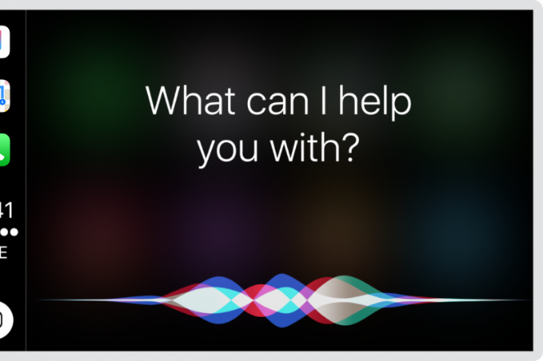
What has accomplished lately?
Speech Recognition

Slide 18
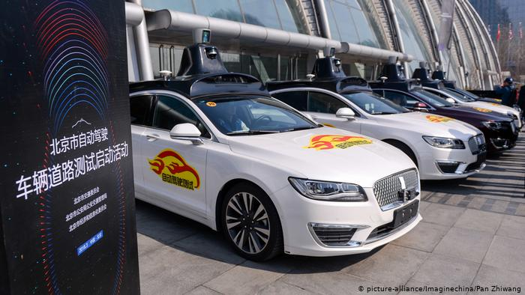
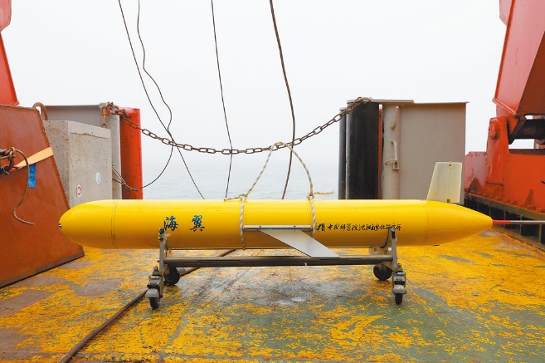
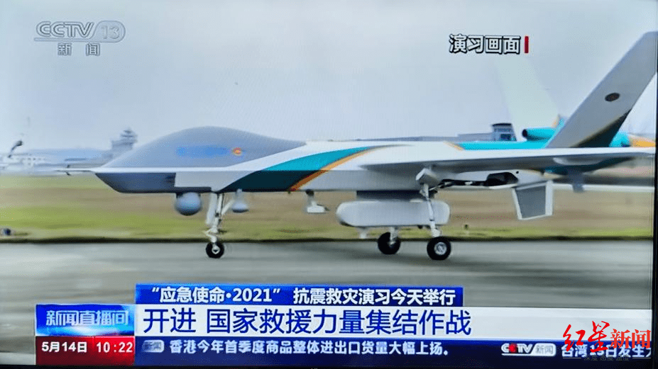
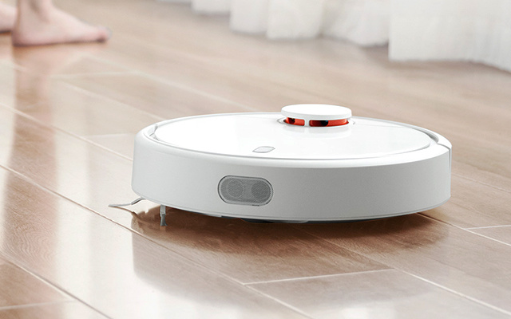
What has accomplished lately?
Robots
Factories, Land, Air, Sea, Mines, Homes

Slide 19
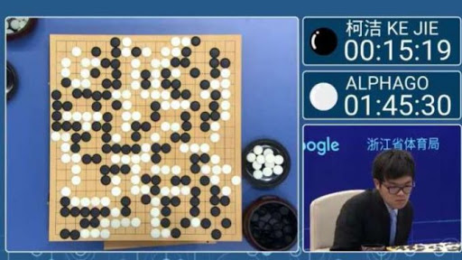

What has accomplished lately?
Games and reasoning

Slide 20
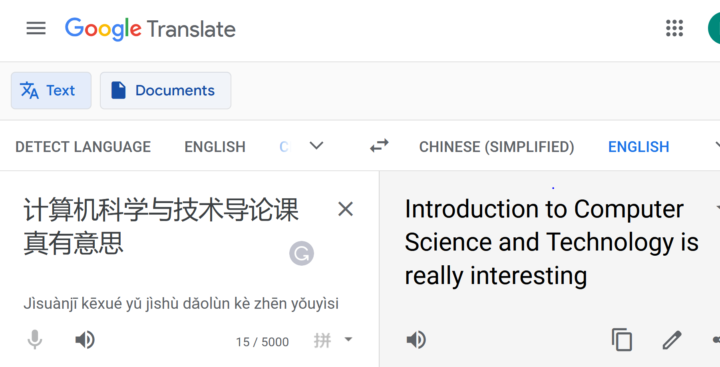
What has accomplished lately?
Medical diagnosis
Fraud detection
Translation
Recommendations

Slide 21
PART D
Brief Introduction to Major Issues in AI

Slide 22
4
Content
PART
PART
PART
4.1 Knowledge Representation
4.2 Solving Problems By searching
4.3 Reasoning
4.4 Learning

Slide 23
4.1
Knowledge Representation
PART
PART
PART
Knowledge in the field of AI
Fact: knowledge of categories and objects
Rule: knowledge of actions, events and their relationship
Concept: knowledge of concepts, principles, theories, models
Meta knowledge: knowledge of knowledge
What is knowledge representation
Knowledge representation is the conceptualization, formalization, or modeling of human knowledge. Using symbols, algorithm and state diagram to describe the problems to be solved.
Knowledge representation = data structure + processing mechanism
Notes:
事实性知识
程序性知识（规则性知识）
概念性知识，是事实性知识的高层
知识表示是把人类知识概念化，形式化表示的一种方法。使用符号算法描述解决问题的方法。

Slide 24
4.1
Knowledge Representation
PART
PART
PART
Requirements of knowledge representation methods
Expressing ability
Comprehensibility
Conducive to knowledge acquirement
Conducive to search
Conducive to reasoning

Slide 25
4.1
Knowledge Representation
PART
PART
PART
The main methods：
State space method
Problem specification method
Predicate logic method
Semantic network method
Frame representation
Ontology representation
Process representation
Neural network representation
Notes:
状态空间法 问题说明方法 谓词逻辑方法 语义网络方法 帧表示 本体表示 过程表示 神经网络表示
状态空间法、问题归约法、谓词逻辑法、语义网络法。

Slide 26
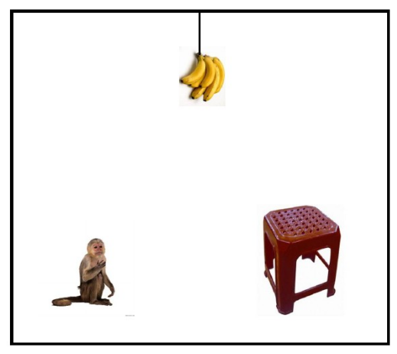

4.1
Knowledge Representation
PART
PART
PART
Example: Monkey and Banana
Problem description: In a room, there was a monkey, a box and a bunch of bananas. The banana hangs below the ceiling, but the monkey is not high enough to touch it. So how does this monkey pick up the banana?

Slide 27
4.1
Knowledge Representation
PART
PART
PART
Monkey and Banana - State space method
Quadruple（W，x，y，z）
W：Monkey’s horizontal position.
X：x=1 when the monkey is on the top of the box; otherwise, x=0.
Y：the horizontal position of box.
Z：z=1 when the monkey pick banana; otherwise, z=0.
Operator
(1) goto(U): go to horizontal position U.
(2) pushbox(V): push the box to horizontal position V.
(3) climbbox: monkey climb on the top of the box.
(4) grasp: get the banana.
Notes:
状态空间
语义网络
知识图谱

Slide 28
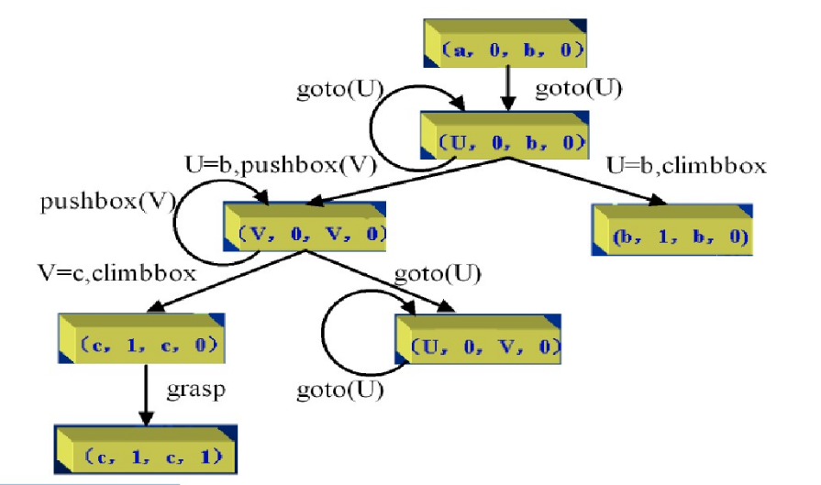
4.1
Knowledge Representation
PART
PART
PART
Monkey and Banana - State space method
Let the initial state be (a,0,b,0). At this time, goto (U) is the only applicable operation and leads to the next state.
There are now three applicable operations: goto(U), pushbox(V) and climbbox(if U=b).
To apply all of the applicable operations to each state, we can get the state space diagram, as shown in the figure below.
It is not difficult to see from the figure that the sequence of operations that transforms the initial state into the target state is {goto(b), pushbox(c), climbbox, grasp}.
Notes:
这个状态图其实就是知识。通过这个状态图整个解决这个问题的前前后后，就告诉计算机了。同样的的问题计算机就可以解了

Slide 29
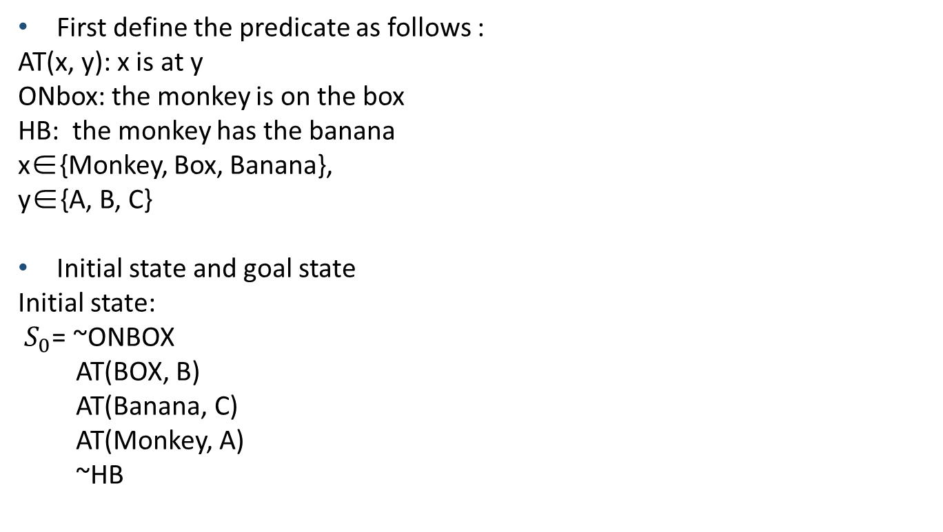
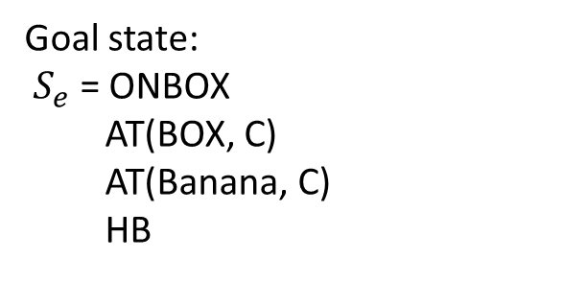
4.1
Knowledge Representation
PART
PART
PART
Monkey and Banana - Predicate logic method
First define the predicate as follows :
AT(x, y): x is at y
ONbox: the monkey is on the box
HB: the monkey has the banana
x∈{Monkey, Box, Banana},
y∈{A, B, C}
Initial state and goal state
Initial state:
$S_{0}$= ~ONBOX
AT(BOX, B)
AT(Banana, C)
AT(Monkey, A)
~HB
Goal state:
$S_{e}$ = ONBOX
AT(BOX, C)
AT(Banana, C)
HB

Slide 30
4.1
Knowledge Representation
PART
PART
PART
Monkey and Banana - Predicate logic method
Operation is composed of:
Condition: The conditions that must be fulfilled by the action are expressed by the predicate formula;
Action: The operation of the state of the problem changes, by performing the operation in the problem state to delete and add the corresponding predicate to express.

Slide 31
4.1
Knowledge Representation
PART
PART
PART
Monkey and Banana - Predicate logic method
Four Operations:
1. Goto(u, v)
condition: ~ONBOX, AT(Monkey, u)
action: delete AT(Monkey, u), add AT(Monkey, v)
2. Pushbox(v, w)
condition: ~ONBOX, AT(Monkey, v), AT(Box, v)
action: delete AT(Monkey, v), AT(Box, v); add AT(Monkey, w), AT(BOX, w)
3. Climbbox
condition: ~ONBOX, AT(Monkey, w)
action: delete ~ONBOX, add ONBOX
4. Grasp
condition: ONBOX, AT(Box, C), ~HB
action: delete ~HB, add HB

Slide 32
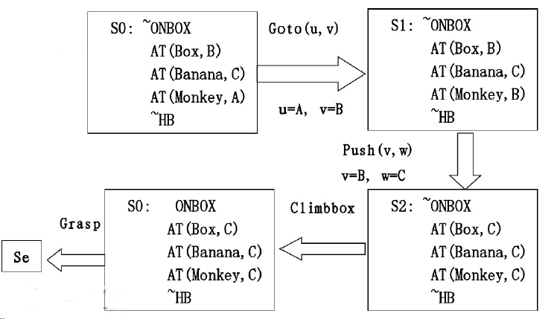
4.1
Knowledge Representation
PART
PART
PART
Monkey and Banana - Predicate logic method
Notes:
大家感受一下，早期的人工智能，就这样，人类的知识哪是能够用规则概念表示完的？这就是为啥人工智能走入第二个寒冬的原因。
于是在事实表示这里，目前最新的知识自动化，语义网络，知识森林。大家下去阅读材料。

Slide 33
4.2
Solving problems by searching
PART
PART
PART
Searching
Uninformed search algorithms | Informed search algorithms
Breadth-First Search | A genetic algorithm(GA)
Depth-First Search | Heuristic search
Uniform-Cost Search | Hill-climbing Search
Depth-Limited Search | A*
Breadth-Limited Search | Simulated annealing
… | …
Notes:
还有一类问题呢？不需要人去总结规律。决策空间就是那么几个。
以是否有利用信息来引导可将搜索划分为无信息搜索和有信息搜素。
属于无信息搜索的算法有：广度优先算法，深度优先算法，等代价搜索，深度有限搜索，迭代加深搜索算法等。
属于有信息搜索的算法有：遗传算法，启发式算法，爬山算法，A*算法，模拟退火算法等。

Slide 34
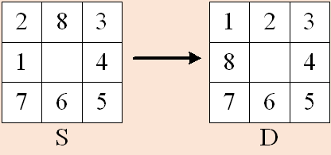
4.2
Uninformed Search Algorithms
PART
PART
PART
The 8-puzzle problem is played on a 3-by-3 grid with 8 square blocks labeled 1 through 8 and a blank square. You are permitted to slide blocks horizontally or vertically into the blank square.
Your goal is to rearrange the blocks so that they are in order.
S---start
D---destination
Notes:
8-数码问题是在3*3的网格中进行，其中有8个正方形积木和一个正方形空白区。积木只能水平地或垂直地滑入空白区。
目标是整理积木达成它们的次序。
S---表示起始
D---表示目标

Slide 35
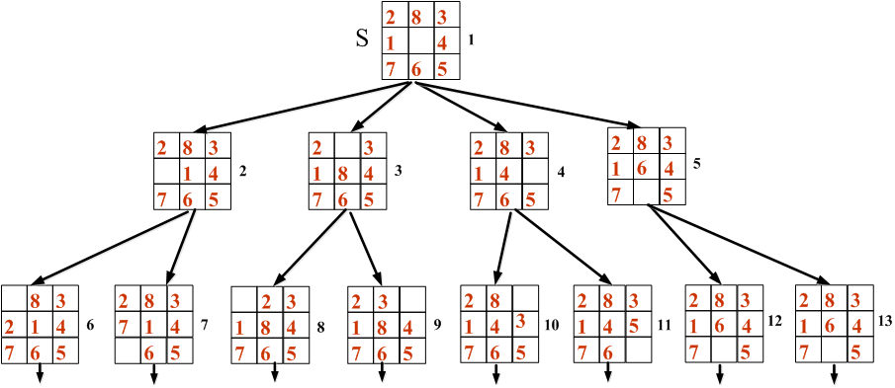
4.2
Uninformed Search Algorithms
PART
PART
PART
Strategy: Breadth-First Search
Notes:
策略：“广度优先”搜索
指定规则如：“依次将搜索到的节点作为搜索节点”
数字1，2，3…表示搜索的次序。

Slide 36
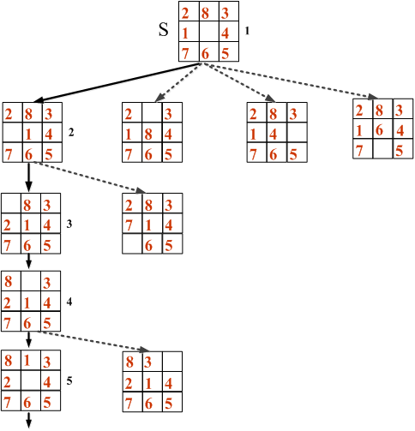
4.2
Uninformed Search Algorithms
PART
PART
PART
Strategy: Depth-First Search
Notes:
策略：“深度优先”搜索
指定规则如：“持续将上一个搜索节点所搜索到的第一个节点作为此次的搜索节点”
数字1，2，3…表示搜索的次序。
实线表示作出的搜索选择。
虚线表示其它可能的有效搜索。

Slide 37
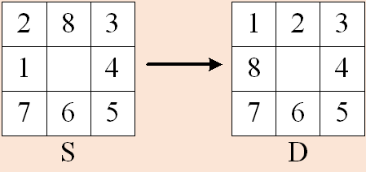
4.2
Informed Search Algorithms
PART
PART
PART
Strategy: Heuristic search
Evaluation function:
f(n)=d(n)+M(n)
d(n) --- the depth of the node n in the search tree ,
M(n)--- the number of the misplaced pieces corresponding to the node n.
f(S)=d(S)+M(S)
=0+4
=4
Notes:
下面介绍有信息搜索算法。
策略：启发式搜索
d(n)表示搜索树中的“深度”。起始节点其深度定义为0。
M(n)表示相对于目标节点，错放的正方形积木的个数。
f(S)表示起始节点S的评价函数=0+4=4。

Slide 38
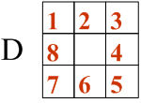
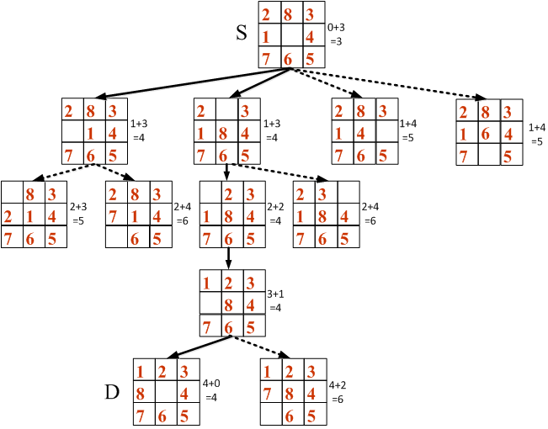
4.2
Informed Search Algorithms
PART
PART
PART
Notes:
实线表示作出的搜索选择。
虚线表示其它可能的有效搜索。

Slide 39
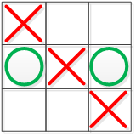
4.2
Adversarial search
PART
PART
PART
Adversarial search problems—often known as games.
In AI, the most common games are of a rather specialized kind—what game theorists call deterministic, turn-taking, two-player, zero-sum games of perfect information.
Example：tic-tac-toe
Notes:
对抗搜索问题----通常被称为博弈。
在人工智能中“博弈”通常是更特定的种类---专指博弈专家们称为有完整信息的、确定的、轮流行动的、两个游戏者的零和游戏。
例：一字棋（只要三个子能连成线就算赢）
MAX此人用绿圆棋，MIN这个人用红叉棋。图中MAX获胜。

Slide 40
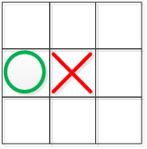
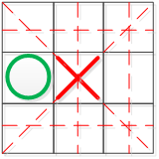
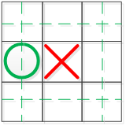
4.2
Adversarial search
PART
PART
PART
Evaluation function: f(S)
S
f(S)=6-4=2
Notes:
博弈的各方总是要挑选对自己最为有利而对对方最不利的那个行动方案。我们用评价函数f(p)来对棋局的有利程度进行估计。
f(S)＝（所有空格都放上MAX的棋子之后，MAX的三子成线（行、列、对角）的总数） －（所有空格都放上MIN的棋子之后，MIN的三子成线（行、列、对角）的总数）
如图所示，f(S)=6-4=2. 用圆圈内的数字2表示。

Slide 41
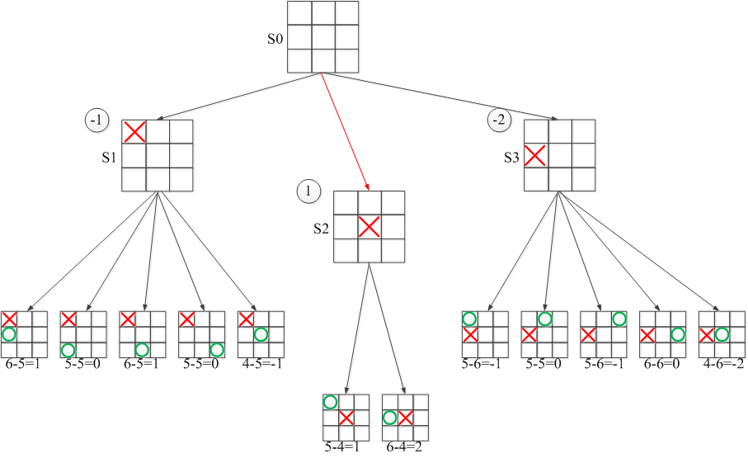
4.2
Adversarial search
PART
PART
PART
Notes:
蒙特卡洛搜索树。
初始状态S0出发有三种可能状态S1,S2,S3.所生成的博弈树如图所示。
若下棋如S1，则最坏的结果是-1，即表示输；
若下棋如S2，则最坏的结果是1，即表示赢；
若下棋如S3，则最坏的结果是-2，即表示输；
所以，从初始状态S0出发，S2是最有利的走棋。

Slide 42
4.3
Reasoning
PART
PART
PART
Reasoning is the drawing of inference or conclusion from known or assumed facts.
Two types:
Deduction
making an inference based on widely accepted facts or premises
Induction
making an inference based on an observation, often of a sample

Slide 43
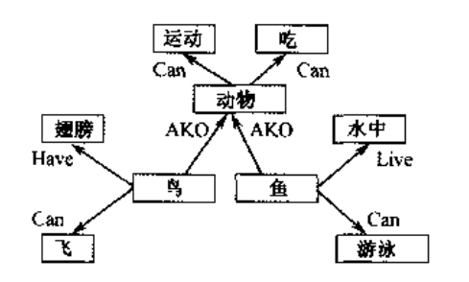
4.3
Reasoning
PART
PART
PART
Semantic network is a graphic notation for representing knowledge in patterns of interconnected nodes.
Inherit
match

Slide 44
4.4
Learning
PART
PART
PART
Machine Learning
a specific subset of Artificial Intelligence that trains a machine how to become “intelligence”
is a study of algorithms that
improve their performance P
at some task T
with experience E
well-defined learning task: <P,T,E>
Notes:
用经验(数据)，提升某项特定任务时的性能

Slide 45
4.4
Learning: example
PART
PART
PART
Task
Learn the function
F: board -> move
Performance
Maximize number of games won
Experience
supervised training examples from experts:
<board, expert_move>
Notes:
举例，学习围棋任务时的任务，经验，和性能

Slide 46
4.4
Learning: example
PART
PART
PART
Task
Learn function
F: image(t) -> steering(t), accelerator(t), brake(t)
Performance
Minimize
[c1 drive_time_home + c2 vehicles_hit + c3 pedestrians_hit]
Experience
Self driving experiments in driving simulator
Notes:
举例，自动驾驶任务时的任务，经验，和性能

Slide 47
4.4
Learning
PART
PART
PART
Traditional Programming
Machine Learning
Data
Computer
Output
Program
Data
Computer
Program
Output
Notes:
传统变成和机器学习时的区别，主要在于input output 的变化

Slide 48
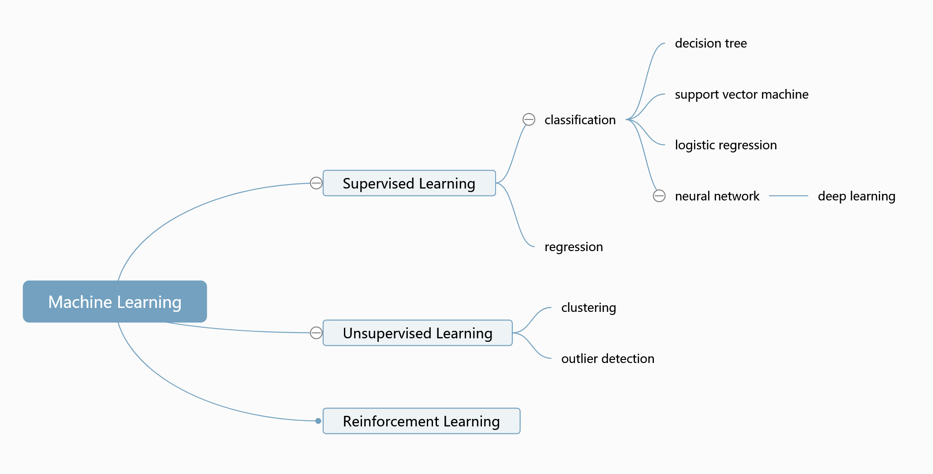
4.4
Learning
PART
PART
PART
Notes:
监督学习，无监督学习，强化学习

Slide 49
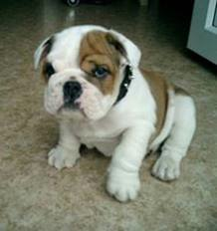
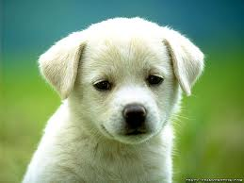


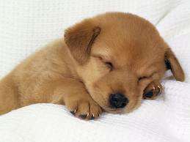
4.4
Supervised Learning
PART
PART
PART
Training
This is a dog
This is a dog
This is a cat
What is this?
Testing
This is a dog!
Supervised learning (with training): training set to teach models to yield the desired output

Slide 50
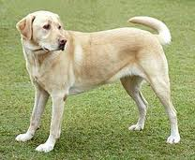



4.4
Unsupervised Learning
PART
PART
PART
Cluster 2
Cluster 1
Dog, cat, cow?
Supervised learning (with training): Using training set to teach models to yield the desired output
Unsupervised learning: learning patterns from untagged data

